Slide 1
EDGE DETECTION USING ANOVA
DATE OF REVIEW :
11 SEPTEMBER 2015
GUIDED BY:
DR. MALATHI

Slide 2
GROUP MEMBERS
1)SHIIVONG KAPIL BIRLA -13BCE1137
2)KASHISH KOHLI -13BCE1067
3)BHARGAV MANIAR -13BCE1075

Slide 3
ABSTRACT
This project will be the implementation for edge detection. With this project we will be able to highlight the edges in an image.
There are 3 types of edges, 1)Unilateral, 2) Bilateral and 3) Multilateral.
We shall also be discussing about various types of edges and steps in edge detection.

Slide 4
SOFTWARE USED
The software that we will be making use of is MATLAB.
The hardware implementation (if any) will not be done in this project.

Slide 5
MODULES PLANNED
There are 2 modules we have in mind.
1) Edge detection using ANOVA.
2) Edge detection without using ANOVA.

Slide 6
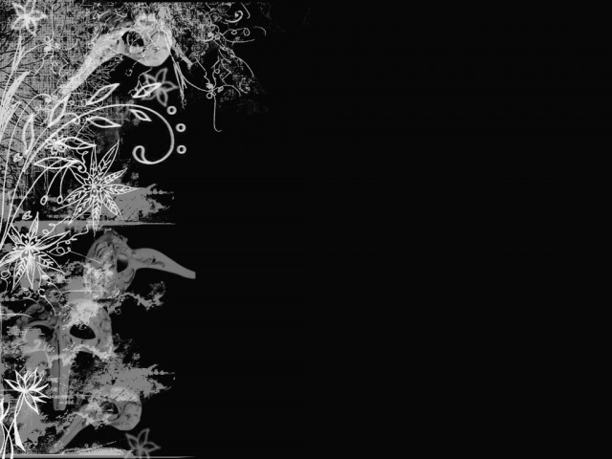


INTRODUCTION
Edge - Area of significant change in the image intensity / contrast
Edge Detection – Locating areas with strong intensity contrasts
Use of Edge Detection – Extracting information about the image. E.g. location of objects present in the image, their shape, size, image sharpening and enhancement

Slide 7

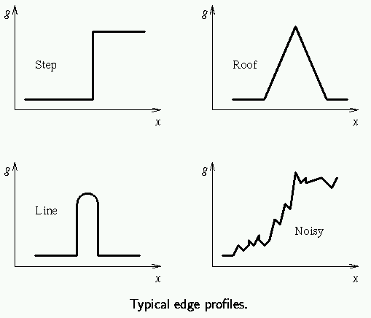
TYPES OF EDGES
Variation of Intensity / Gray Level
Step Edge
Ramp Edge
Line Edge
Roof Edge

Slide 8

Steps in Edge Detection
Filtering – Filter image to improve performance of the Edge Detector wrt noise
Enhancement – Emphasize pixels having significant change in local intensity
Detection – Identify edges - thresholding
Localization – Locate the edge accurately, estimate edge orientation

Slide 9
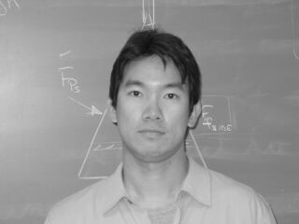
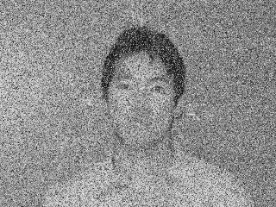
Noisy Image
Example of Noisy Image

Slide 10
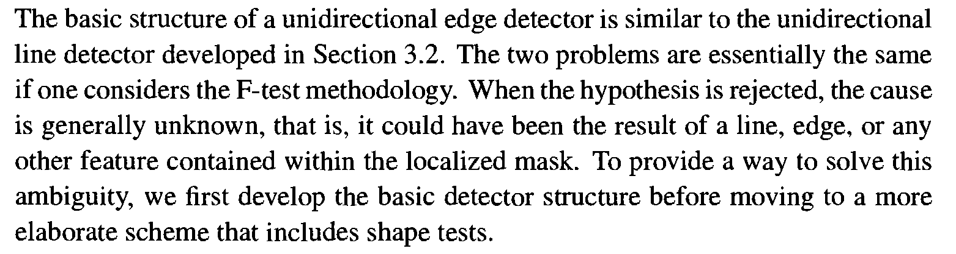
UNIDIRECTIONAL EDGE DETECTOR

Slide 11
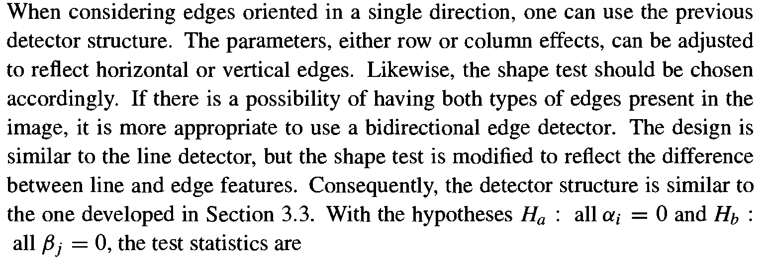
BIDIRECTIONAL EDGE DETECTORS

Slide 12
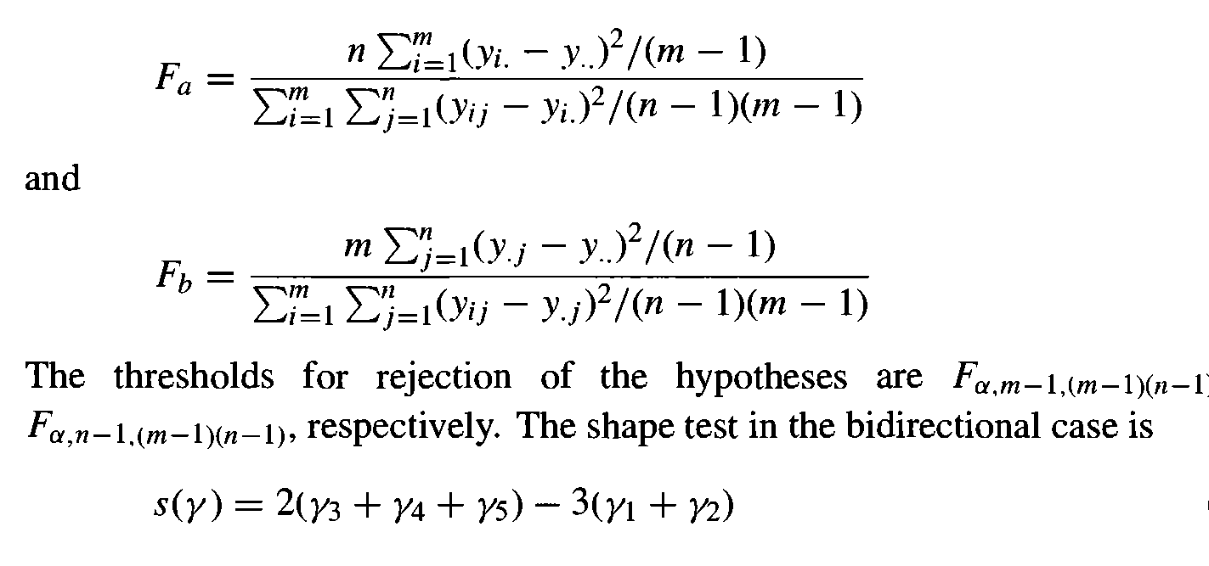
CONT.

Slide 13
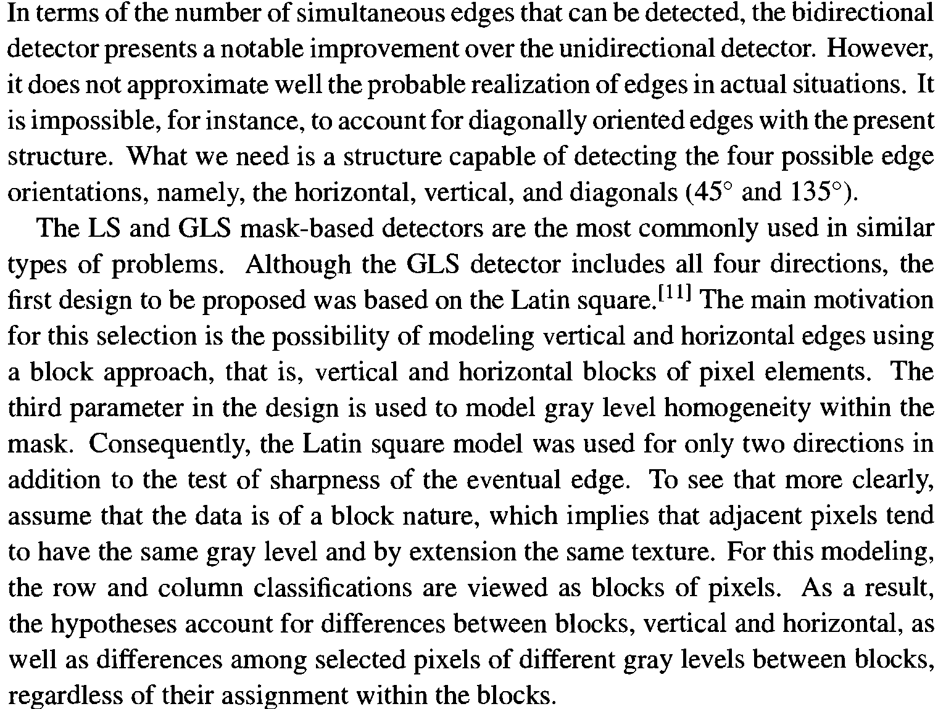
MULTIDIRECTIONAL EDGE DETECTORS

Slide 14
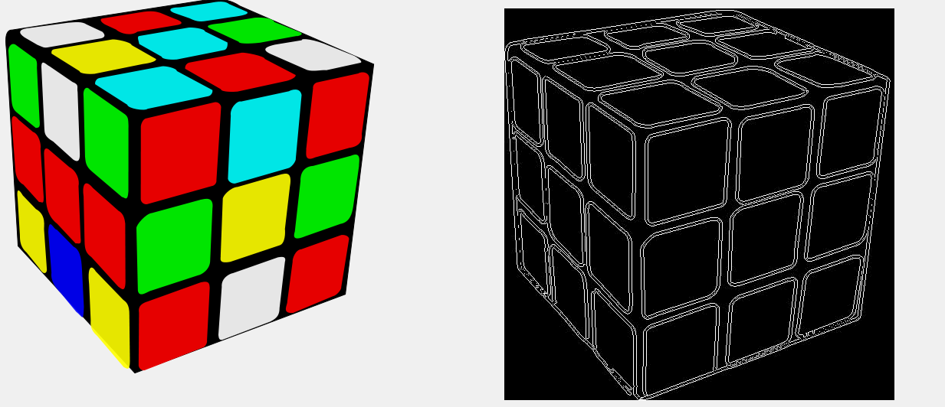
CONCLUSION
Hence we’ll show edge detection with/without using ANOVA.

Slide 15
SCOPE FOR ENHANCEMENT
The scope of enhancement is there are many upcoming algorithm’s such as Robert’s algorithm for edge detection are being made more effective and better in it’s implementation.

Slide 16
THANK YOU

